Slide 1

Subject Name: Software Engineering
Unit No:3 Unit Name :
Software Project planning and management
Faculty Name : Mrs Snehal Patil

Slide 2
Index
Lecture 16 – Software Metrics: Size Metrics like LOC
Lecture 17- Token Count, Function Count
Lecture18 - Cost estimation using models like COCOMO
Software Process Models

Slide 3
Unit No:3 Unit Name: Software Project planning and management
Lecture No: 16
Software Metrics: Size Metrics like LOC

Slide 4
Software Metrics
A software metric is a measure of software characteristics which are measurable or countable. Software metrics are valuable for many reasons, including measuring software performance, planning work items, measuring productivity, and many other uses.
Within the software development process, many metrics are that are all connected. Software metrics are similar to the four functions of management: Planning, Organization, Control, or Improvement.
Software Process Models

Slide 5
Importance of Software Metrics
Test metrics are essential in determining the software’s quality and performance. Developers may use the right software testing metrics to improve their productivity.
Test metrics help to determine what types of enhancements are required in order to create a defect-free, high-quality software product.
Make informed judgments about the testing phases that follow, such as project schedule and cost estimates.
Examine the current technology or procedure to see if it need any more changes.
Software Process Models

Slide 6
Classification of Software Metrics
Software metrics can be classified into two types as follows:
1. Product Metrics: These are the measures of various characteristics of the software product. The two important software characteristics are:
Size and complexity of software.
Quality and reliability of software.
These metrics can be computed for different stages of SDLC.
2. Process Metrics: These are the measures of various characteristics of the software development process. For example, the efficiency of fault detection. They are used to measure the characteristics of methods, techniques, and tools that are used for developing software.
Software Process Models

Slide 7
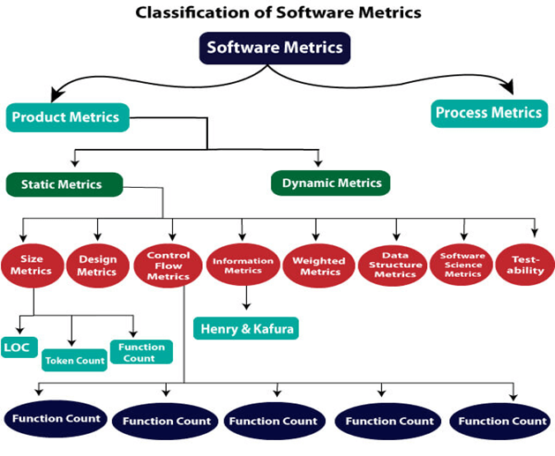
Software Process Models

Slide 8
Types of Metrics
Internal metrics: Internal metrics are the metrics used for measuring properties that are viewed to be of greater importance to a software developer. For example, Lines of Code (LOC) measure.
External metrics: External metrics are the metrics used for measuring properties that are viewed to be of greater importance to the user, e.g., portability, reliability, functionality, usability, etc.
Hybrid metrics: Hybrid metrics are the metrics that combine product, process, and resource metrics. For example, cost per FP where FP stands for Function Point Metric.
Project metrics: Project metrics are the metrics used by the project manager to check the project's progress. Data from the past projects are used to collect various metrics, like time and cost; these estimates are used as a base of new software. Note that as the project proceeds, the project manager will check its progress from time-to-time and will compare the effort, cost, and time with the original effort, cost and time. Also understand that these metrics are used to decrease the development costs, time efforts and risks. The project quality can also be improved. As quality improves, the number of errors and time, as well as cost required, is also reduced.
Software Process Models

Slide 9
Advantage of Software Metrics
Comparative study of various design methodology of software systems.
For analysis, comparison, and critical study of different programming language concerning their characteristics.
In comparing and evaluating the capabilities and productivity of people involved in software development.
In the preparation of software quality specifications.
In the verification of compliance of software systems requirements and specifications.
In making inference about the effort to be put in the design and development of the software systems.
In getting an idea about the complexity of the code.
Software Process Models

Slide 10
Size Oriented Metrics / LOC Metrics
A line of code (LOC) is any line of text in a code that is not a comment or blank line, and also header lines, in any case of the number of statements or fragments of statements on the line. LOC clearly consists of all lines containing the declaration of any variable, and executable and non-executable statements. As Lines of Code (LOC) only counts the volume of code, you can only use it to compare or estimate projects that use the same language and are coded using the same coding standards.
Features :
Variations such as “source lines of code”, are used to set out a codebase.
LOC is frequently used in some kinds of arguments.
They are used in assessing a project’s performance or efficiency.
Software Process Models

Slide 11
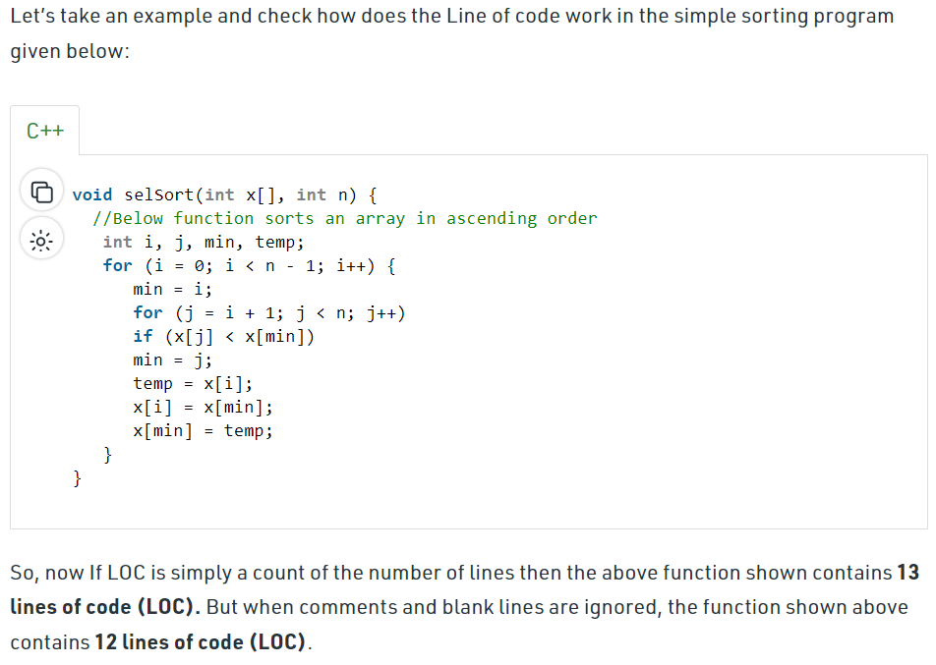
Size Oriented Metrics/LOC Metrics
Software Process Models

Slide 12
Size Oriented Metrics / LOC Metrics
It is one of the earliest and simpler metrics for calculating the size of the computer program.
It is generally used in calculating and comparing the productivity of programmers. These metrics are derived by normalizing the quality and productivity measures by considering the size of the product as a metric.
Following are the points regarding LOC measures:
LOC is considered to be the normalization value.
Productivity is defined as KLOC / EFFORT, where effort is measured in person-months.
Size-oriented metrics depend on the programming language used
Software Process Models

Slide 13
Cont..
LOC measure requires a level of detail which may not be practically achievable.
The more expressive is the programming language, the lower is the productivity.
LOC method of measurement does not apply to projects that deal with visual (GUI-based) programming. As already explained, Graphical User Interfaces (GUIs) use forms basically. LOC metric is not applicable here.
Based on the LOC/KLOC count of software, many other metrics can be computed:
Errors/KLOC.
$/ KLOC.
Defects/KLOC.
Pages of documentation/KLOC.
Errors/PM.
Productivity = KLOC/PM (effort is measured in person-months).
$/ Page of documentation.
Software Process Models

Slide 14
Unit No:3 Unit Name: Software Project planning and management
Lecture No: 17 Token Count, Function Count

Slide 15
Functional Point (FP) Analysis
FPA is used to make estimate of the software project, including its testing in terms of functionality or function size of the software product.
The functional size of the product is measured in terms of the function point, which is a standard of measurement to measure the software application.
The basic and primary purpose of the functional point analysis is to measure and provide the software application functional size to the client, customer, and the stakeholder on their request. Further, it is used to measure the software project development along with its maintenance, consistently throughout the project irrespective of the tools and the technologies.
Software Process Models

Slide 16
Following are the points regarding FPs
1. FPs of an application is found out by counting the number and types of functions used in the applications. Various functions used in an application can be put under five types, as shown in Table:
Types of FP Attributes
Measurements Parameters | Examples
1.Number of External Inputs(EI) | Input screen and tables
2. Number of External Output (EO) | Output screens and reports
3. Number of external inquiries (EQ) | Prompts and interrupts.
4. Number of internal files (ILF) | Databases and directories
5. Number of external interfaces (EIF) | Shared databases and shared routines.
Software Process Models

Slide 17
Following are the points regarding FPs
FP characterizes the complexity of the software system and hence can be used to depict the project time and the manpower requirement.
The effort required to develop the project depends on what the software does.
FP is programming language independent.
FP method is used for data processing systems, business systems like information systems.
Software Process Models

Slide 18
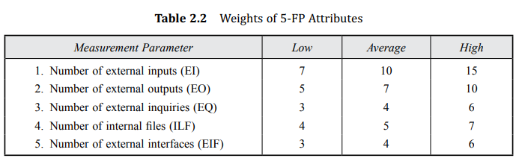
Following are the points regarding FPs
The five parameters mentioned above are also known as information domain characteristics. All the parameters mentioned are assigned some weights that have been experimentally determined and are shown in Table. Weights of 5-FP Attributes.
Software Process Models

Slide 19
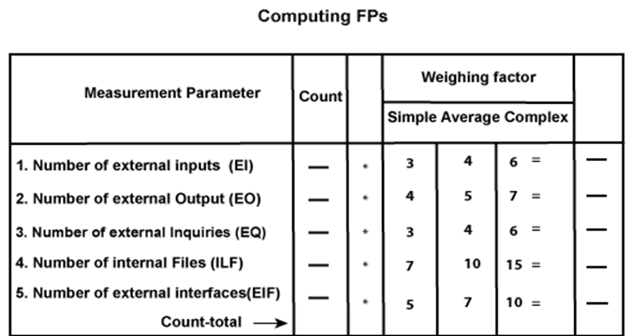
Following are the points regarding FPs
The functional complexities are multiplied with the corresponding weights against each function and the values are added up to determine the UFP (Unadjusted Function Point) of the subsystem. So we draw another Table 2.3 now.
Software Process Models

Slide 20
Cont.
The functional complexities are multiplied with the corresponding weights against each function, and the values are added up to determine the UFP (Unadjusted Function Point) of the subsystem.
Here that weighing factor will be simple, average, or complex for a measurement parameter type.
The Function Point (FP) is thus calculated with the following formula.
FP = Count-total * [0.65 + 0.01 * ∑(f_{i})]
= Count-total * CAF
where Count-total is obtained from the above Table.
CAF = [0.65 + 0.01 *∑(f_{i})]
and ∑(f_{i}) is the sum of all 14 questionnaires and show the complexity adjustment value/ factor-CAF (where i ranges from 1 to 14). Usually, a student is provided with the value of ∑(f_{i})
Software Process Models

Slide 21
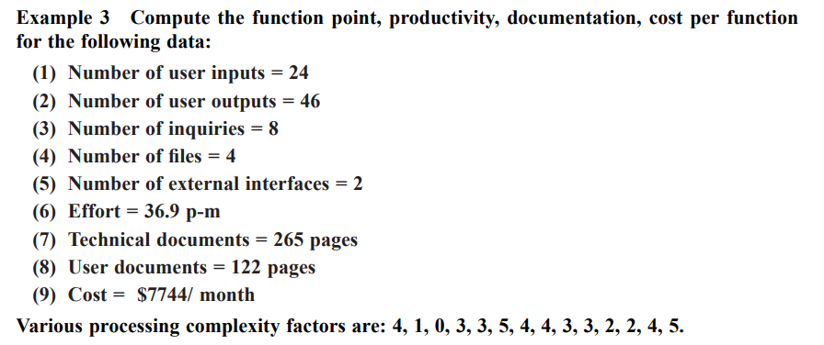
Example Function Point calculation
Software Process Models

Slide 22
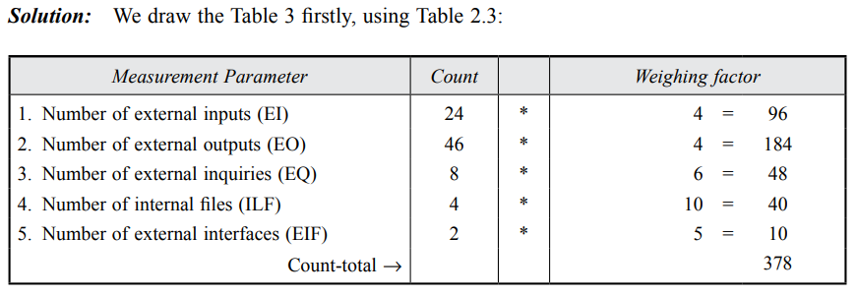
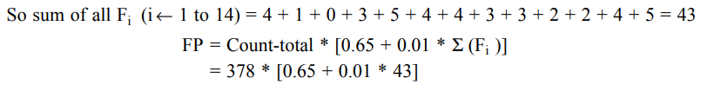

Example Function Point calculation
Software Process Models

Slide 23


FP = Count-total * [0.65 + 0.01 *∑(fi)]
= 378 * [0.65 + 0.01 * 43]
= 378 * [0.65 + 0.43]
= 378 * 1.08 = 408
Functional Point (FP) Analysis
Total pages of documentation = technical document + user document
= 265 + 122 = 387pages
Documentation = Pages of documentation/FP
= 387/408 = 0.94
Software Process Models

Slide 24
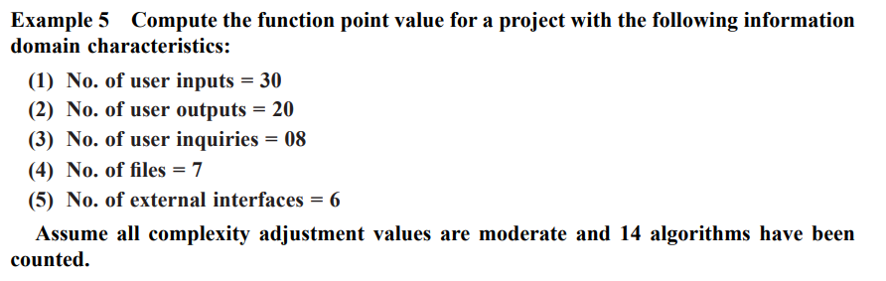
For Student
Software Process Models

Slide 25
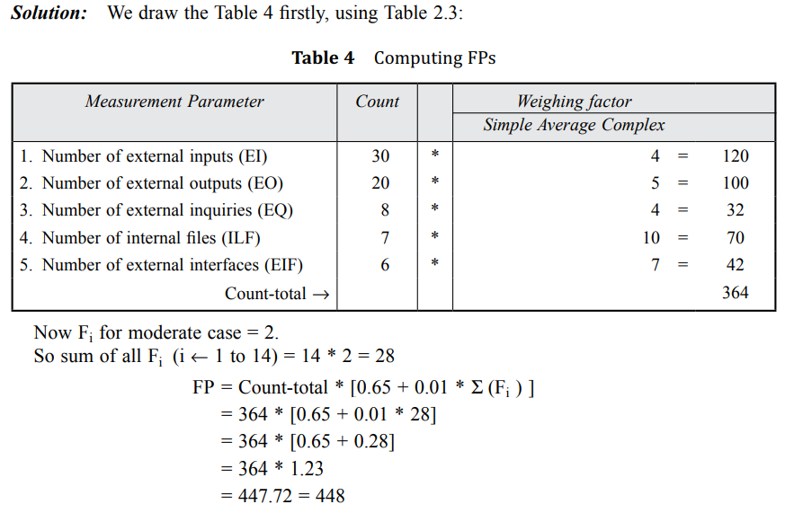
Solution
Software Process Models

Slide 26
Differentiate between FP and LOC
FP | LOC
1. FP is specification based. | 1. LOC is an analogy based.
2. FP is language independent. | 2. LOC is language dependent.
3. FP is user-oriented. | 3. LOC is design-oriented.
4. It is extendible to LOC. | 4. It is convertible to FP (backfiring)
Software Process Models

Slide 27
Unit No:3 Unit Name: Software Project planning and management
Lecture No: 18 Cost estimation using models like
COCOMO

Slide 28
Software Cost Estimation
For any new software project, it is necessary to know how much it will cost to develop and how much development time will it take. These estimates are needed before development is initiated, but how is this done? Several estimation procedures have been developed and are having the following attributes in common.
Project scope must be established in advanced.
Software metrics are used as a support from which evaluation is made.
The project is broken into small PCs which are estimated individually.
To achieve true cost & schedule estimate, several option arise.
Delay estimation
Used symbol decomposition techniques to generate project cost and schedule estimates.
Acquire one or more automated estimation tools.
Software Process Models

Slide 29
COCOMO Model
Boehm proposed COCOMO (Constructive Cost Estimation Model) in 1981.
COCOMO is one of the most generally used software estimation models in the world. COCOMO predicts the efforts and schedule of a software product based on the size of the software.
The necessary steps in this model are:
Get an initial estimate of the development effort from evaluation of thousands of delivered lines of source code (KDLOC).
Determine a set of 15 multiplying factors from various attributes of the project.
Calculate the effort estimate by multiplying the initial estimate with all the multiplying factors i.e., multiply the values in step1 and step2.
Software Process Models

Slide 30
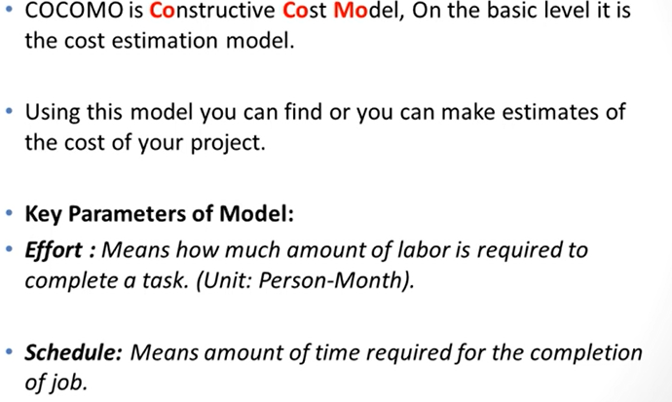
COCOMO Model
Software Process Models

Slide 31
The initial estimate (also called nominal estimate) is determined by an equation of the form used in the static single variable models, using KDLOC as the measure of the size.
To determine the initial effort E_{i} in person-months the equation used is of the type is shown below
E_{i}=a*(KDLOC)b
The value of the constant a and b are depends on the project type.
Software Process Models

Slide 32
COCOMO model
In COCOMO, projects are categorized / Levels into three types:
Organic
Semidetached
Embedded
Organic: A development project can be treated of the organic type, if the project deals with developing a well-understood application program, the size of the development team is reasonably small, and the team members are experienced in developing similar methods of projects. Examples of this type of projects are simple business systems, simple inventory management systems, and data processing systems.
Software Process Models

Slide 33
COCOMO model
Semidetached: A development project can be treated with semidetached type if the development consists of a mixture of experienced and inexperienced staff. Team members may have finite experience in related systems but may be unfamiliar with some aspects of the order being developed. Example of Semidetached system includes developing a new operating system (OS), a Database Management System (DBMS), and complex inventory management system.
Embedded: A development project is treated to be of an embedded type, if the software being developed is strongly coupled to complex hardware, or if the stringent regulations on the operational method exist. For Example: ATM, Air Traffic control.
Software Process Models

Slide 34
Classification of COCOMO model
For three product categories, Bohem provides a different set of expression to predict effort (in a unit of person month)and development time from the size of estimation in KLOC(Kilo Line of code) efforts estimation takes into account the productivity loss due to holidays, weekly off, coffee breaks, etc.
According to Boehm, software cost estimation should be done through three stages:
Basic Model
Intermediate Model
Detailed Model
Software Process Models

Slide 35
Basic COCOMO Model:
Basic COCOMO Model: The basic COCOMO model gives an approximate estimate of the project parameters. It means it predict the efforts & cost of the project.
The basic COCOMO model provide an accurate size of the project parameters.
The following expressions give the basic COCOMO estimation model:
Effort=a₁*(KLOC) a₂ PM
Tdev=b₁*(efforts)b₂ Months
Where
KLOC is the estimated size of the software product indicate in Kilo Lines of Code,
a₁,a₂,b₁,b₂ are constants for each group of software products
Tdev is the estimated time to develop the software, expressed in months
Effort is the total effort required to develop the software product, expressed in person months (PMs).
Software Process Models

Slide 36
Basic COCOMO Model:
Estimation of development effort
For the three classes of software products, the formulas for estimating the effort based on the code size are shown below:
Organic: Effort = 2.4(KLOC) 1.05 PM
Semi-detached: Effort = 3.0(KLOC) 1.12 PM
Embedded: Effort = 3.6(KLOC) 1.20 PM
Estimation of development time
For the three classes of software products, the formulas for estimating the development time based on the effort are given below:
Organic: Tdev = 2.5(Effort) 0.38 Months
Semi-detached: Tdev = 2.5(Effort) 0.35 Months
Embedded: Tdev = 2.5(Effort) 0.32 Months
Software Process Models

Slide 37
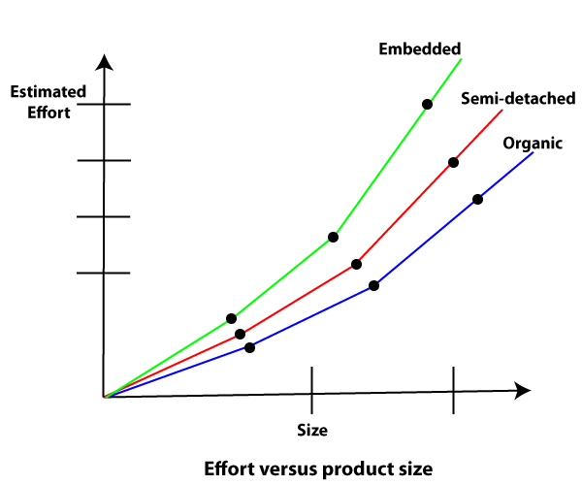
Basic COCOMO model can be obtained by plotting the estimated characteristics for different software sizes. Fig shows a plot of estimated effort versus product size. From fig, we can observe that the effort is somewhat superliner in the size of the software product. Thus, the effort required to develop a product increases very rapidly with project size.
Software Process Models

Slide 38
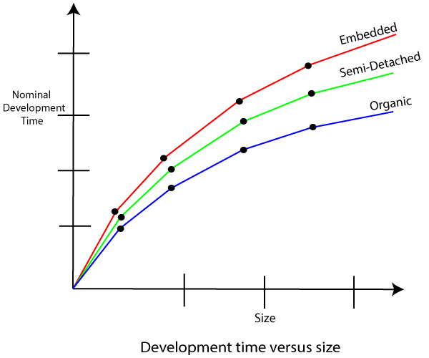
The development time versus the product size in KLOC is plotted in fig. From fig it can be observed that the development time is a sub linear function of the size of the product, i.e. when the size of the product increases by two times, the time to develop the product does not double but rises moderately.
Software Process Models

Slide 39
Intermediate Model:
The basic Cocomo model considers that the effort is only a function of the number of lines of code and some constants calculated according to the various software systems.
This is an extension version of Basic COCOM Model. The intermediate COCOMO model recognizes these facts and refines the initial estimates obtained through the basic COCOMO model by using a set of 15 cost drivers / additional predictors based on various attributes of software engineering.
Software Process Models

Slide 40
Classification of Cost Drivers and their attributes:
(i) Product attributes -
Required software reliability extent
Size of the application database
The complexity of the product
(ii) Hardware attributes -
Run-time performance constraints
Memory constraints
The volatility of the virtual machine environment
Required turnabout time
Software Process Models

Slide 41
Personnel attributes -
Analyst capability
Software engineering capability
Applications experience
Virtual machine experience
Programming language experience
Project attributes -
Use of software tools
Application of software engineering methods
Required development schedule
Software Process Models

Slide 42
Detailed COCOMO Model
Detailed COCOMO incorporates all qualities of the standard version with an assessment of the cost driver?s effect on each method of the software engineering process.
The detailed model uses various effort multipliers for each cost driver property. In detailed cocomo, the whole software is differentiated into multiple modules, and then we apply COCOMO in various modules to estimate effort and then sum the effort.
The Six phases of detailed COCOMO are:
Planning and requirements
System structure
Complete structure
Module code and test
Integration and test
Cost Constructive model
The effort is determined as a function of program estimate, and a set of cost drivers are given according to every phase of the software lifecycle.
Software Process Models

Slide 43
Example1: Suppose a project was estimated to be 400 KLOC. Calculate the effort and development time for each of the three model i.e., organic, semi-detached & embedded.
Coefficients for intermediate COCOMO
Project | a_{i} | b_{i} | c_{i} | d_{i}
Organic | 2.4 | 1.05 | 2.5 | 0.38
Semidetached | 3.0 | 1.12 | 2.5 | 0.35
Embedded | 3.6 | 1.20 | 2.5 | 0.32
Software Process Models

Slide 44
Examples
Suppose a project was estimated to be 400 KLOC. Calculate the effort and development time for each of the three model i.e., organic, semi-detached & embedded.
Solution: The basic COCOMO equation takes the form:
Effort=a₁*(KLOC) a₂ PM
Tdev=b₁*(efforts)b₂ Months
Estimated Size of project= 400 KLOC
(i)Organic Mode
E = 2.4 * (400)1.05 = 1295.31 PM
D = 2.5 * (1295.31)0.38=38.07 PM
(ii)Semidetached Mode
E = 3.0 * (400)1.12=2462.79 PM
D = 2.5 * (2462.79)0.35=38.45 PM
(iii) Embedded Mode
E = 3.6 * (400)1.20 = 4772.81 PM
D = 2.5 * (4772.8)0.32 = 38 PM
Software Process Models

Slide 45
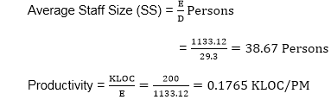
Examples
Example2: A project size of 200 KLOC is to be developed. Software development team has average experience on similar type of projects. The project schedule is not very tight. Calculate the Effort, development time, average staff size, and productivity of the project.
Solution: The semidetached mode is the most appropriate mode, keeping in view the size, schedule and experience of development time.
Hence E=3.0(200)1.12=1133.12PM
D=2.5(1133.12)0.35=29.3PM
P = 176 LOC/PM
Software Process Models

Slide 46

Thank You

